Slide 1
MA(q) | Properties and Characteristics

Slide 2
Moving Average (MA) Models
Used to model stationary data
But not as useful as AR models for modeling actual stationary data
They are useful in combination with the AR model to create the ARMA models, which are a useful extension of the AR models
We first briefly study the moving average (MA) model
Remember George Box’s quote:
All models are wrong… but some are useful.

Slide 3
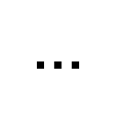
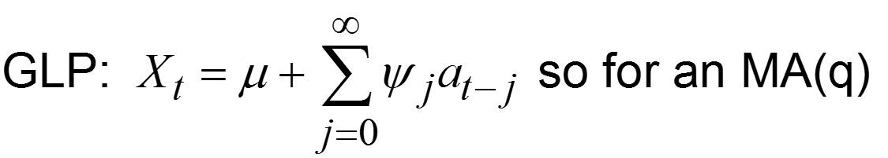
Moving Average Model of Order q: MA(q)
Where the θ_{j}’s are real constants and a_{t}’s are white
Notes:
X_{t} at time t is a linear combination of present and past noise components
An MA(q) is a finite GLP and is always stationary
Already in GLP form!
$$Example: MA\left(1\right): X_{t}=4+a_{t}+−.9a_{t−1}+0a_{t−2 …}$$

Slide 4
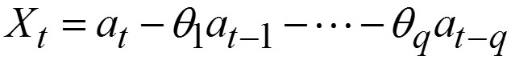
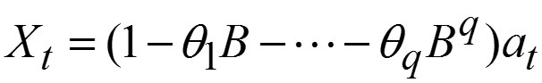
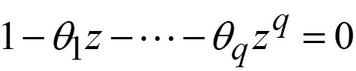
Moving Average Model of Order q: MA(q)
Zero mean form
Operator zero mean form
MA-characteristic equation

Slide 5
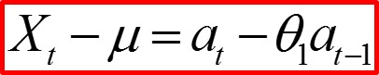
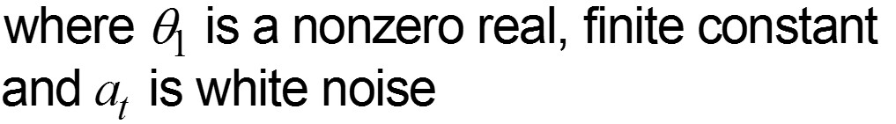
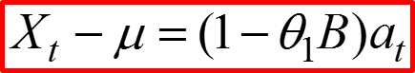
Moving Average Model of Order 1: MA(1)
Operator form
Zero mean operator form
Notes:
Chuiping developed discrete Euler processes in 2002. This process has a close relationship with Autoregressive model. That is, the present value has linear relationship with past p values. However, the time points are different. AR(p) process has k, k-1… time points but.. EAR process has h to the power k…
If we take log bas h transformation on time, the EAR process become AR process
EAR has linear multiplicative values

Slide 6
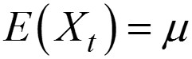
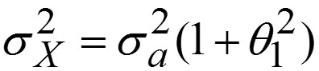
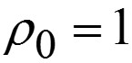
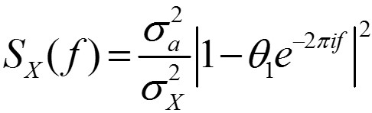
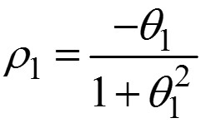
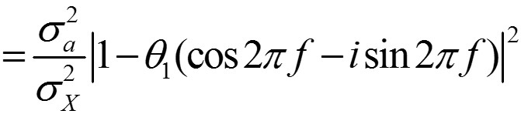
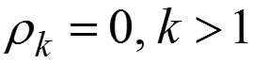
MA(1) results:
Mean
Variance
Autocorrelations
Spectral density

Slide 8
Example
MA(1)

Slide 9
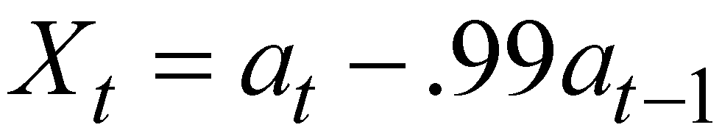
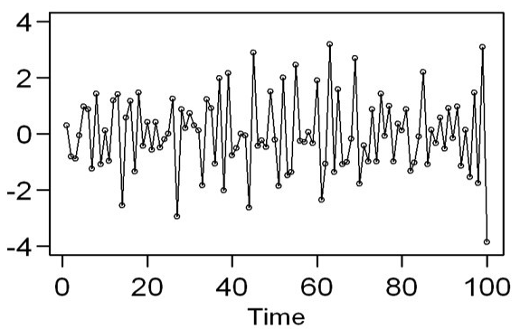
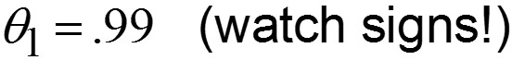
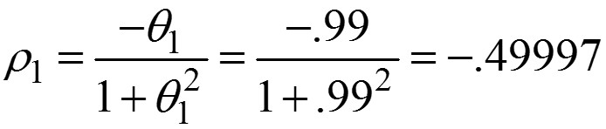
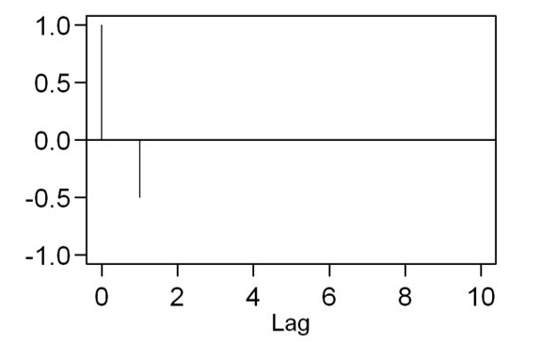
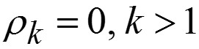
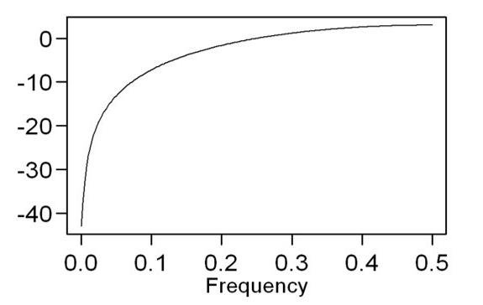
Example:
Note: For an MA(1), max |ρ₁| = .5.
Note: MA(1) spectral densities do not have “peaks.” Instead, they have “dips.”

Slide 10
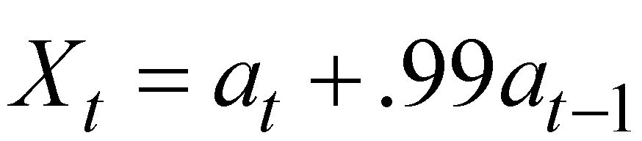
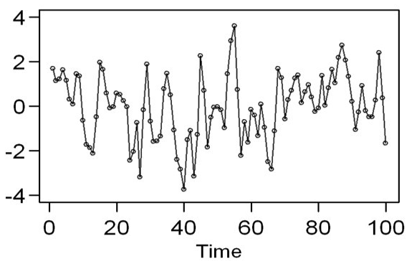
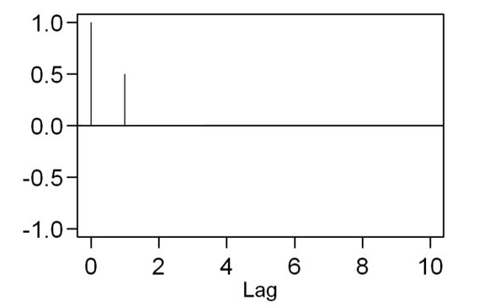
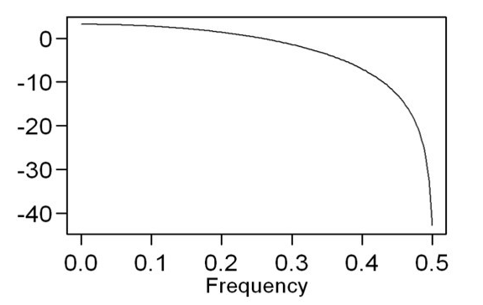
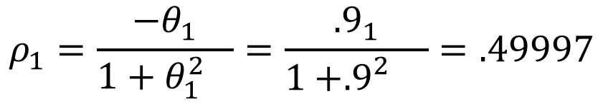
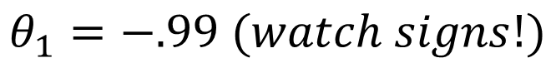
Example:
$$θ_{1}=−.99 (watch signs!)$$
$$ρ_{1}=\frac{−θ_{1}}{1+{θ_{1}^{2}}_{}}=\frac{{.9}_{1}}{1+{{.9}_{}^{2}}_{}}=.49997$$
Note: For an MA(1), max |ρ₁| = .5.
Note: MA(1) spectral densities do not have “peaks.” Instead they have “dips.”

Slide 12
Example
MA(2)

Slide 13
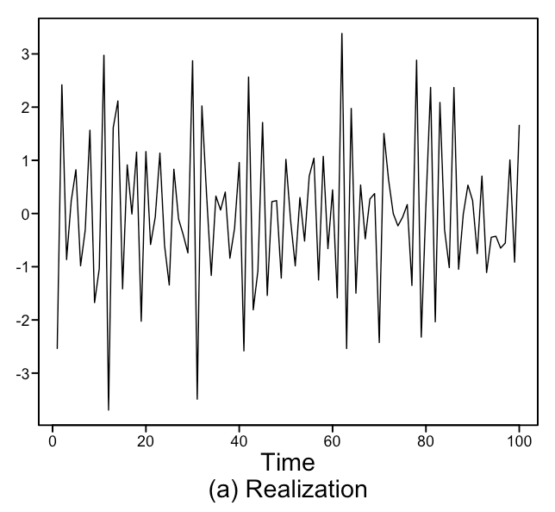
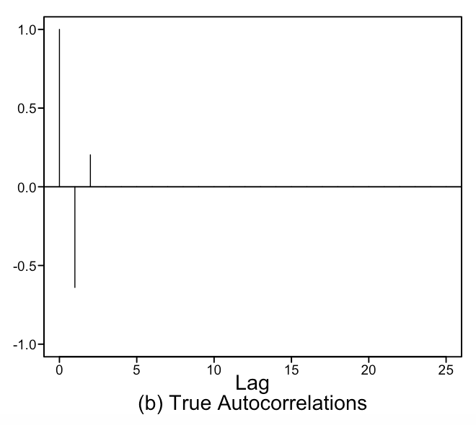
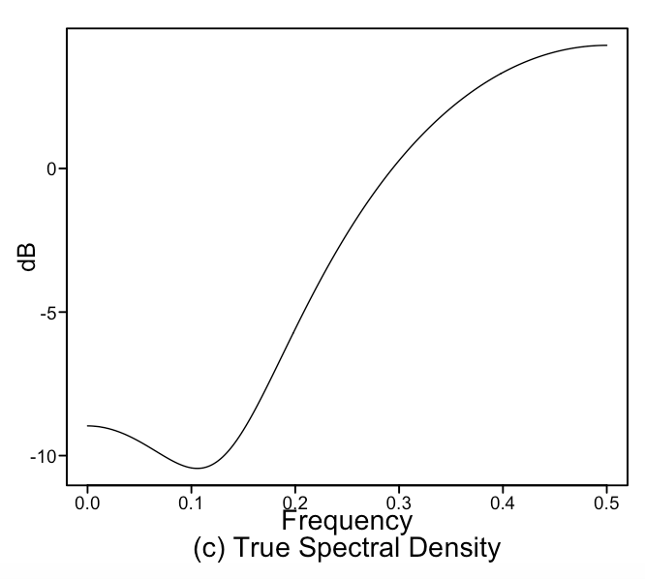
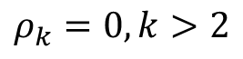
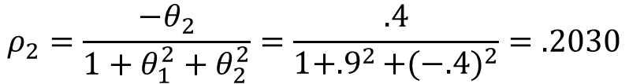
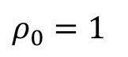
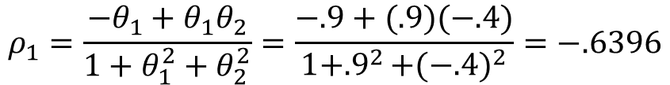
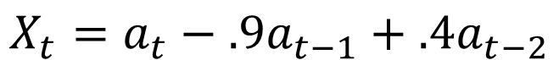
Next, We Briefly Consider the MA(2) Model:
Autocorrelations
Example:
$$X_{t}=a_{t}−.9a_{t−1}+.4a_{t−2}$$
$$ρ_{0}=1$$
$$ρ_{1}=\frac{−θ_{1}+θ_{1}θ_{2}}{1+θ_{1}^{2}+θ_{2}^{2}}=\frac{−.9+(.9)(−.4)}{1+{.9}^{2}+{(−.4)}^{2}}=−.6396$$
$$ρ_{2}=\frac{−θ_{2}}{1+θ_{1}^{2}+θ_{2}^{2}}=\frac{.4}{1+{.9}^{2}+{(−.4)}^{2}}=.2030$$
$$ρ_{k}=0, k>2$$

Slide 14
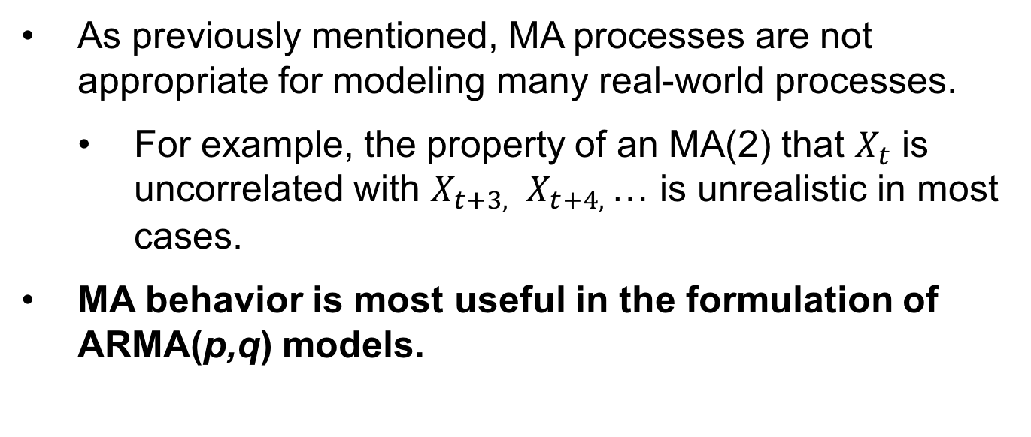
Key Feature of MA(q)
For an MA(q), ρ_{k} = 0, k > q
Other notes about MA(q) processes
As previously mentioned, MA processes are not appropriate for modeling many real-world processes.
For example, the property of an MA(2) that $X_{t}$ is uncorrelated with $X_{t+3, }$ $X_{t+4, }$… is unrealistic in most cases.
MA behavior is most useful in the formulation of ARMA(p,q) models.
Notes:
Need more examples here ... There is a screen share after this though.

Slide 16
MA(q) | tswge and MA Models

Slide 17
tswge demo
The following command generates and plots a realization from an MA, AR, or ARMA model.
gen.arma.wge(n,phi,theta,vara,sn)
Notes:
For MA models, theta is a constant for q = 1 and a vector for q > 1. For an MA(q), phi takes on its default value of 0.
+ sn=0 (default) generates a new (randomly obtained) realization each time. Setting sn > 0 allows you to generate the same realization each time you apply the command with the same sn.
gen.arma.wge(n=100,theta=-.99)
gen.arma.wge(n=100,theta=-.99)
gen.arma.wge(n=100,theta=-.99,sn=5)
gen.arma.wge(n=100,theta=-.99,sn=5)
gen.arma.wge(n=100,theta=c(.9,-.4)

Slide 18
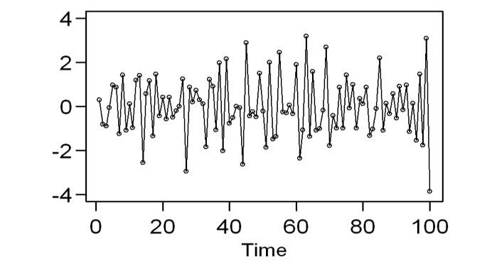
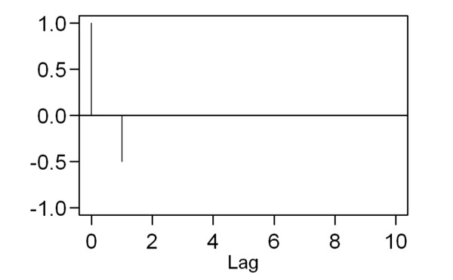
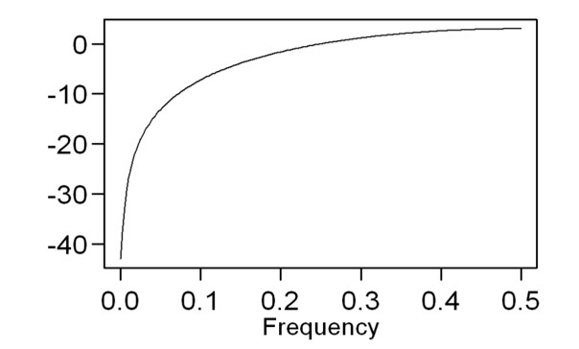
tswge demo
The following command plots a realization of length n (default = 100), the true autocorrelations, and the spectral density for an MA, AR, or ARMA model.
plotts.true.wge(n,phi,theta,lag.max)
Example:
plotts.true.wge(theta=c(.99))
plotts.true.wge(theta=c(.9,-.4))

Slide 20
MA(q) | tswge
MA and Dip in Spectral Density

Slide 21
Demo: Dip in Spectral Density
Consider the MA(2) model:
First, recall the spectral density of
plotts.true.wge(phi=c(1.1,-.9))
Now, what does the spectral density of
look like?
plotts.true.wge(theta=c(1.1,-.9))

Slide 23
MA(q) Comments

Slide 24
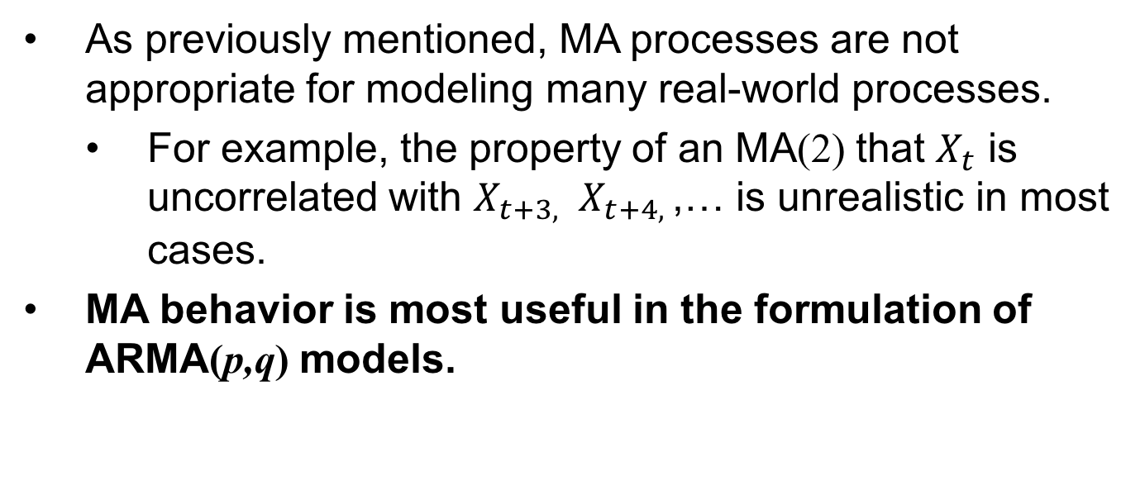
Key Feature of MA(q)
For an MA(q), ρ_{k} = 0, k > q
Other notes about MA(q) processes
As previously mentioned, MA processes are not appropriate for modeling many real-world processes.
For example, the property of an MA(2) that $X_{t}$ is uncorrelated with $X_{t+3, }$ $X_{t+4, }$,… is unrealistic in most cases.
MA behavior is most useful in the formulation of ARMA(p,q) models.

Slide 26
MA(q) | Invertibility

Slide 27
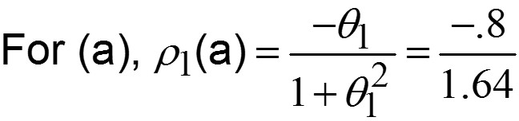
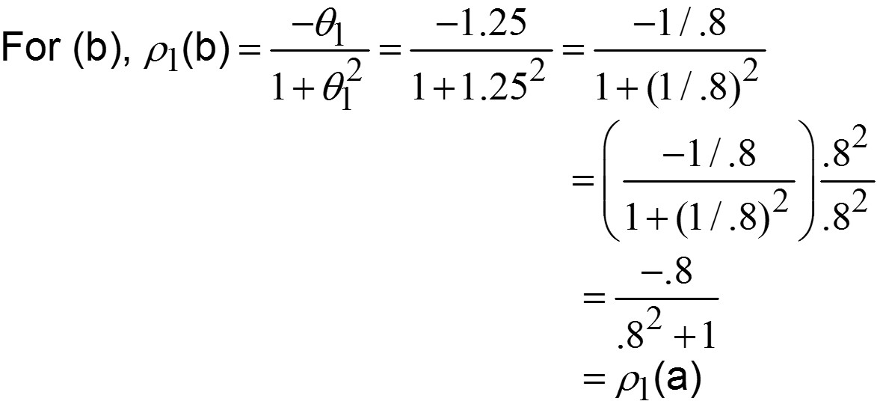
Invertibility
Light board?
Consider the MA(1) processes:
(a) X _{t} = a_{t} – .8 a_{t –1} (b) X _{t} = a_{t} – 1.25 a_{t –1}
= ρ₁(a)

Slide 28
Invertibility
The previous example shows that two different MA(1) models can have the same autocorrelations
ρ₁ is the same for both models, and in each case, ρ₀ = 1 and ρ_{k} = 0, k > 1
Undesirable situation
Called model multiplicity
By restricting our models to invertible models, we can avoid model multiplicity

Slide 29
Which MA Models Are Invertible
An MA(q) model is invertible if and only if the roots of the MA-characteristic equation, θ(z) = 0, are greater than 1 in absolute value.
For the previous example:
Model (a): 1 − .8z = 0 has root 1/.8 = 1.25>1
Model (b): 1 − 1.25z = 0 has root 1/1.25 = .8 < 1
Light board?
Results:
Both models are stationary (all MA models are).
Model (a) is invertible.
We do not consider non-invertible models such as model (b).

Slide 31
MA(q) | tswge and Invertibility

Slide 32
tswge demo
Check for Invertibility
Use factor.wge
-2
factor.wge(phi=c(1.6,-.9))
-2
factor.wge(phi=c(1.6,.9))
Note: The frequency f ₀ shown in the factor table is not a system frequency.
In fact, it is a frequency at which there is a “dip” in the spectrum instead of a peak.

Slide 33
tswge demo
X _{t} = a_{t} – .9 a_{t –1}
X _{t} = a_{t} – 1.111 a_{t –1}
Note: 1/.9 = 1.1111….
Use plotts.true.wge to compare the characteristics of these two models.

Slide 35
ARMA(p,q) | Properties and Characteristics

Slide 36
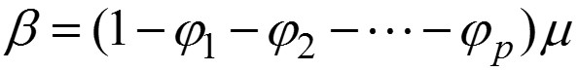
Autoregressive: Moving Average Process of Orders p and q ARMA(p,q)
Where
a _{t} is white noise
ϕ _{i}’s and θ_{j}’s are real constants
ϕ _{p} ≠ 0 and θ_{q} ≠ 0
ϕ (z) and θ (z) have no common factors
Notes:
Chuiping developed discrete Euler processes in 2002. This process has a close relationship with Autoregressive model. That is, the present value has linear relationship with past p values. However, the time points are different. AR(p) process has k, k-1… time points but.. EAR process has h to the power k…
If we take log bas h transformation on time, the EAR process become AR process
EAR has linear multiplicative values

Slide 37
Zero mean form
We will typically use the “zero mean” form of the model.
Operator notation
or
ϕ(B)X_{t}=θ(B)a_{t}

Slide 39
ARMA(p,q) | Cancellation

Slide 40
ARMA(p, q) Model ϕ (B )X _{t} = θ (B )a _{t}
ϕ(B) and θ(B) introduce characteristics of the same type as in the AR(p) and MA(q) cases.
“Near cancellation” may “hide” some characteristics.
Light board

Slide 41
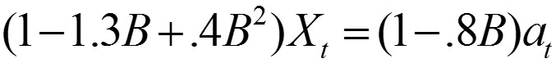
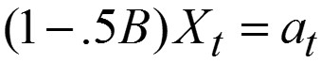
Example: Cancellation
Light board
What model is this?
ARMA(2,1)?
k | ρ _{k}
0 | 1
1 | .5
2 | .25
3 | .125
: | :
1
That is, ρ^{k} = .5^{k},
.5¹
which are the autocorrelations for the AR(1) model
.5²
.5³
(1−.5B)X_{t} = a_{t}.
:
Note:
. Factoring, you get
. By cancellation, we get
(i.e., the model above is an AR(1)).
Notes:
Add an ACF to this one?

Slide 43
ARMA(p,q) | Cancellation

Slide 44
Example: Cancellation
What model is this?
ARMA(2,1)?
k | ρ _{k}
0 | 1
1 | .5
2 | .25
3 | .125
: | :
1
That is, ρ^{k} = .5^{k},
.5¹
which are the autocorrelations for the AR(1) model
.5²
.5³
(1−.5B)X_{t} = a_{t}.
:
Note:
. Factoring, you get
. By cancellation, we get
(i.e., the model above is an AR(1)).
Notes:
Add an ACF to this one?

Slide 45

Cancellation
$$X_{t}−{1.3X}_{t−1}+.4X_{t−2}=a_{t}−.8a_{t−1}$$
$$X_{t}− {.5X}_{t−1}=a_{t}$$
plotts.true.wge(250,phi = c(1.3,-.4),theta = c(.8))
plotts.true.wge(250,phi = c(.5))
The above two models are equivalent due to cancelation of the MA term and a factor in the AR term.

Slide 46
ARMA(p,q) | Blend of AR and MA

Slide 47
ARMA(p, q) Model ϕ (B )X _{t} = θ (B )a _{t}
ϕ(B) and θ(B) introduce characteristics of the same type as in the AR(p) and MA(q) cases.
Key result:
ϕ(B)X_{t} = θ(B)a_{t} is a stationary and invertible ARMA(p,q) process iff:
Roots of ϕ(z) = 0 are all outside the unit circle
Roots of θ(z) = 0 are all outside the unit circle
Note: In order to refer to a process as “ARMA,” we will require it to be stationary and invertible.

Slide 48
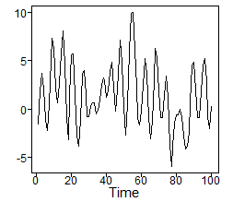
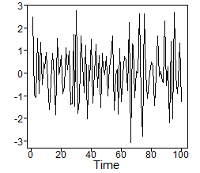
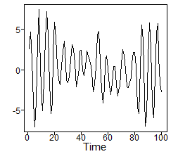
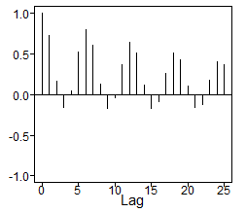





Example
(1 − 1.95B + 1.9B² − .9025B³) X _{t} = a_{t}
X _{t} = (1 − .95B) a _{t}
(1 − 1.95B + 1.9B² − .9025B³) X _{t}
= (1 − .95B)a _{t}
Notes:
MA(1) on the right column? (1-.95B)at?

Slide 49
Notes
The AR(3) part of the model (associated with the second column of graphs) displays:
A periodic behavior of about f = .16
A wandering behavior associated with f = 0; this is shown best in the realization and the spectral density
The MA(1) part of the model is associated with a dip in the spectral density at f = 0.
It tends to “remove” behavior related to f = 0 (i.e., the aimless, aperiodic wandering)
The ARMA(3,1) model retains the cyclic behavior, but the wandering behavior associated with f = 0 has been minimized.

Slide 50












Spectral Densities

Slide 52
ARMA(p,q) | tswge and Illustrating the Blend of AR and MA

Slide 53

What Can You Tell About the ARMA Model from These Plots?
tswge
# AR factors
factor.wge(c(.3,.9,.1,-.8075))
# MA factors
factor.wge(c(-.9,-.8,-.72))
Notes:
IS this a concept check, ICC or and example?

Slide 55
ARMA(p,q) | Example 1
Jet Fuel A

Slide 56
Review: AIC
Akaike’s Information Criterion
Given a set of data, the AIC is used to evaluate and compare the quality of models
Given a set of models, the model with the lowest AIC is thought to have the most quality

Slide 57





Jet Fuel Prices
plotts.wge(jetA$Price)
#UNIT 5 ARMA R CODE
library(tswge)
library(dygraphs)
jetA = read.csv("/Users/bivin/Box/Time Series/UNITS/UNIT 5/Datasets/TexasJetA.csv", header = TRUE)
jetAPrice = rev(jetA$Price)
plotts.wge(jetAPrice[330:408])
aic5.wge(jetAPrice[330:408])
parzen.wge(jetAPrice[330:408])
#Fancey Graph DYGRAPH
jetA$Month2 = as.Date(paste(as.character(jetA$Month),"-01",sep = ""),"%b-%y-%d") #it's tricky getting the Date conveted.
xss = xts(jetA$Price,jetA$Month2)
dygraph(xss) %>% dyRangeSelector(height = 100)
aic.wge(jetA$Price,p = 1, q = 0)$value
aic5.wge(jetA$Price)
aic.wge(jet$Price,p = 2, q = 0)$value
aic.wge(jetA$Price,p = 1, q = 1)$value
ANOTHER GREAT SOURCE OF DATA:
https://datamarket.com/data/list/?q=cat:ego%20provider:tsdl
Texas Kerosene-Type Jet Fuel Retail Sales by Refiners Monthly
https://www.eia.gov/opendata/qb.php?category=244380&sdid=PET.EMA_EPJK_PTG_STX_DPG.M
22:38:59 GMT-0600 (Central Standard Time)
Source: U.S. Energy Information Administration
Awesome source of data:
https://www.eia.gov/opendata/qb.php?category=244380&sdid=PET.EMA_EPJK_PTG_STX_DPG.M

Slide 59
ARMA(p,q) | Example 2
Canadian Lynx

Slide 60

Lynx Data
Log lynx data
Autocorrelations
Spectral density
Year
Lag
Frequency
Notes: The above plots are typical of those produced by AR models for which the characteristic equation has complex conjugate roots.
The log lynx data have a pseudo-cyclic appearance.
The autocorrelations show damped sinusoidal behavior.
The spectral density has a peak at some f₀ between 0 and .5 (at approximately .1 in this case).

Slide 61

Lynx Data
Log lynx data
Autocorrelations
Spectral density
Year
Lag
Frequency

Slide 63
ARMA(p,q) | Example 3
Airline Weather Delay

Slide 64

tswge Another Example: Airline Delays
SWA Monthly Delay Since 2004
ANOTHER GREAT SOURCE OF DATA:
https://datamarket.com/data/list/?q=cat:ego%20provider:tsdl

Slide 66
ARMA(p,q) | PSI Weights

Slide 67





ψ-Weights
As mentioned earlier, the AR, MA, and ARMA processes can all be expressed as general linear processes (GLPs).
The form of the GLP is
Examples
MA
AR
(See Woodward et al., 2017.)
$X_{t}=a_{t}+.8a_{t−1}+.64a_{t−1}$+$.512a_{t−1}$+…

Slide 68
ψ-Weights
Are used in establishing prediction limits on forecasts
They are more difficult to obtain for AR(p) models, p > 1 and ARMA(p,q) models
See Woodward et al. (2017) for calculation techniques.
In this course, we will calculate ψ-weights using tswge command psi.weights.wge

Slide 70
ARMA(p,q) | tswge and PSI Weights

Slide 71
ψ-Weights and tswge
tswge gives ψ₁, ψ₂, …, ψ_{lag.max}.
In all cases, ψ₀ = 1.
# psi-weights for simple MA(1) model X(t)=(1-.8B)a(t)
psi.weights.wge(theta=.8,lag.max=5)
# psi-weights for simple AR(1) model (1-.8B)X(t)=a(t)
psi.weights.wge(phi=.8,lag.max=5) #note that psi(j)=.8^{j}
# psi-weights for ARMA(2,1) model (1-1.2B+.6B²)X(t)=(1-.5B)a(t)
psi.weights.wge(phi=c(1.2,-.6),theta=c(.5),lag.max=5)

Slide 73
ARMA(p,q) | Summary

Slide 74
Comments about ARMA Models
An MA(q) is an ARMA(0,q) model.
An AR(p) is an ARMA(p,0) model.
A stationary and invertible ARMA(p,q) model can be written in the two forms:
A GLP (infinite order MA):
Infinite order AR:
(See Woodward et al., 2017)

Slide 75
Comments about ARMA Models
An ARMA(p,q) can be written as an infinite order AR (form 2).
That is, an ARMA(p,q) model may be able to be approximated by a high-order AR.
Some time series analysts choose to do that and focus on AR models.
Box and Jenkins favor an ARMA model fit over a high-order AR fit.
More “parsimonious” model
That is, fewer parameters
Notes:
If we have more time… show an example of high order AR model approximating the ARMA model. (Or delay till Live Session?)
ALSO GET AN INTERVIEW CLIP HERE ABOUT PARSIMONY … INTERPRETABILITY. GET THIS FROM EVERYONE YOU CAN! AT&T, ACHOHOL DIST, SWA, GET QUIST, REX, MIKIO, ETC.

